Slide 1
Activity Update
Jenna Dickman
Undergraduate Research
Berkeley Autonomous Microsystems Lab, BSAC

Slide 2
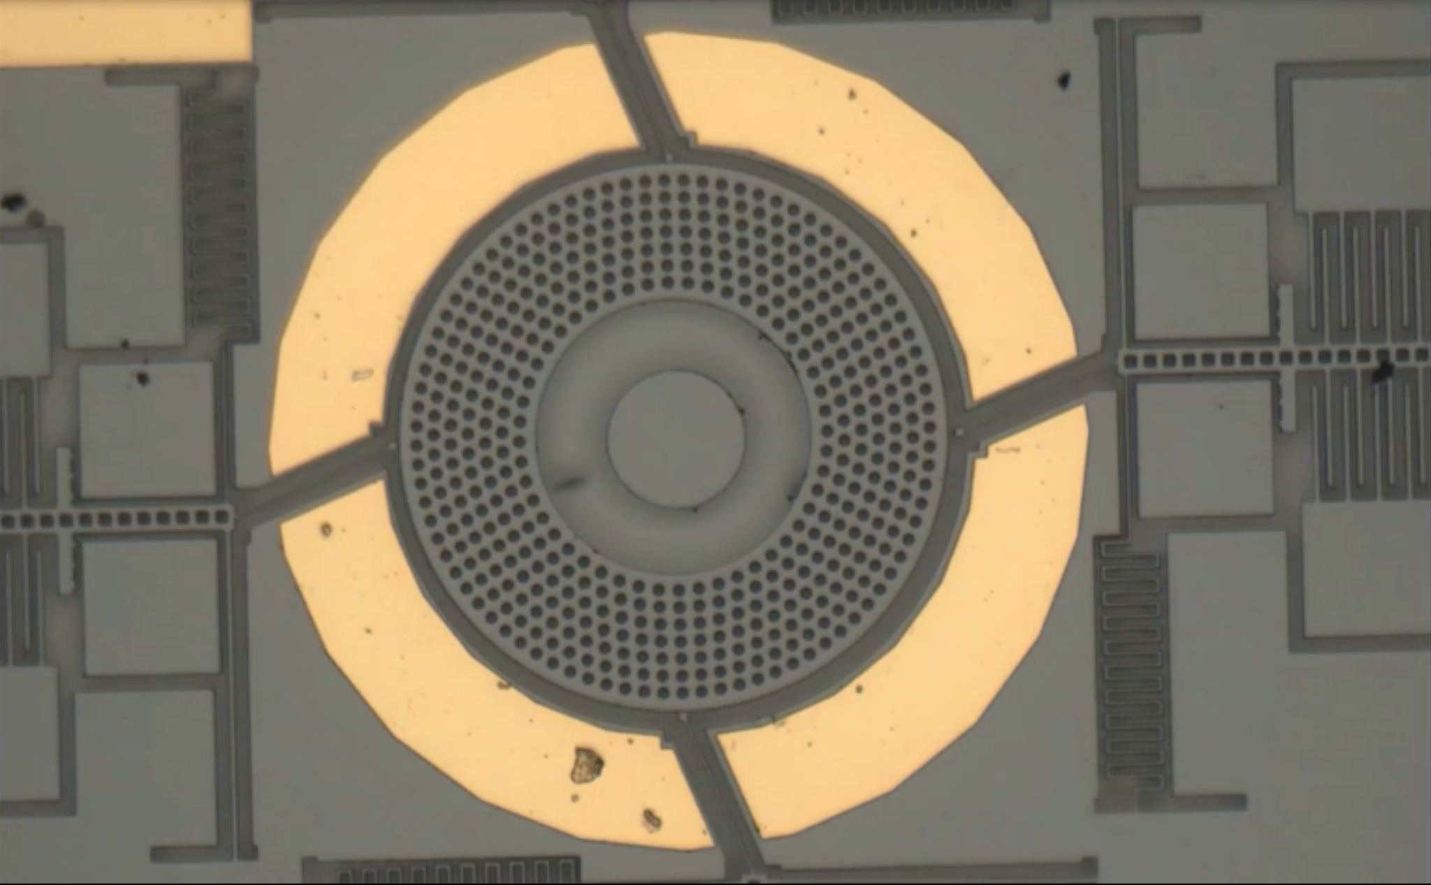
Last semester w/ Mauricio
Motion tracking code for MEMs actuated rotor, outputting plots visualizing pawl actuation and rotor rotation
Image stitching program
Probe station testing

Slide 3
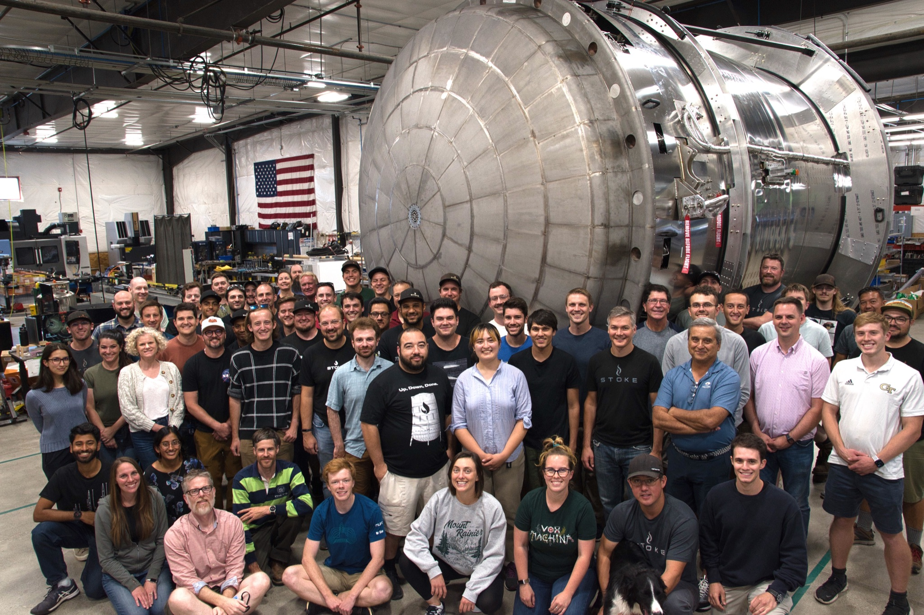
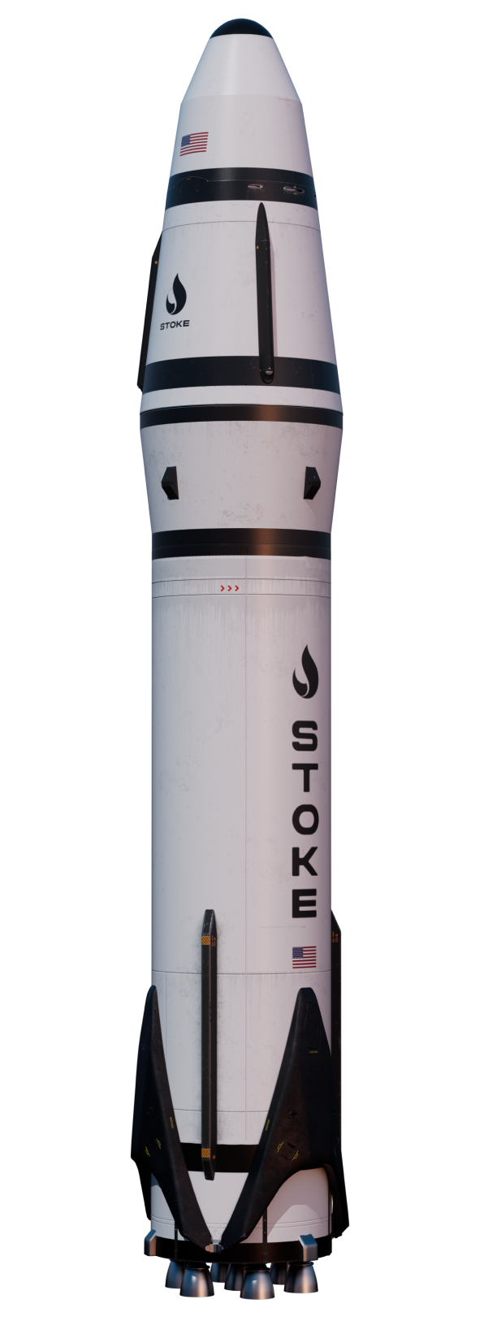
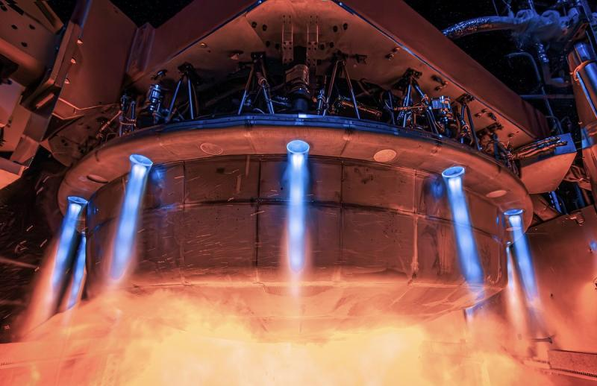
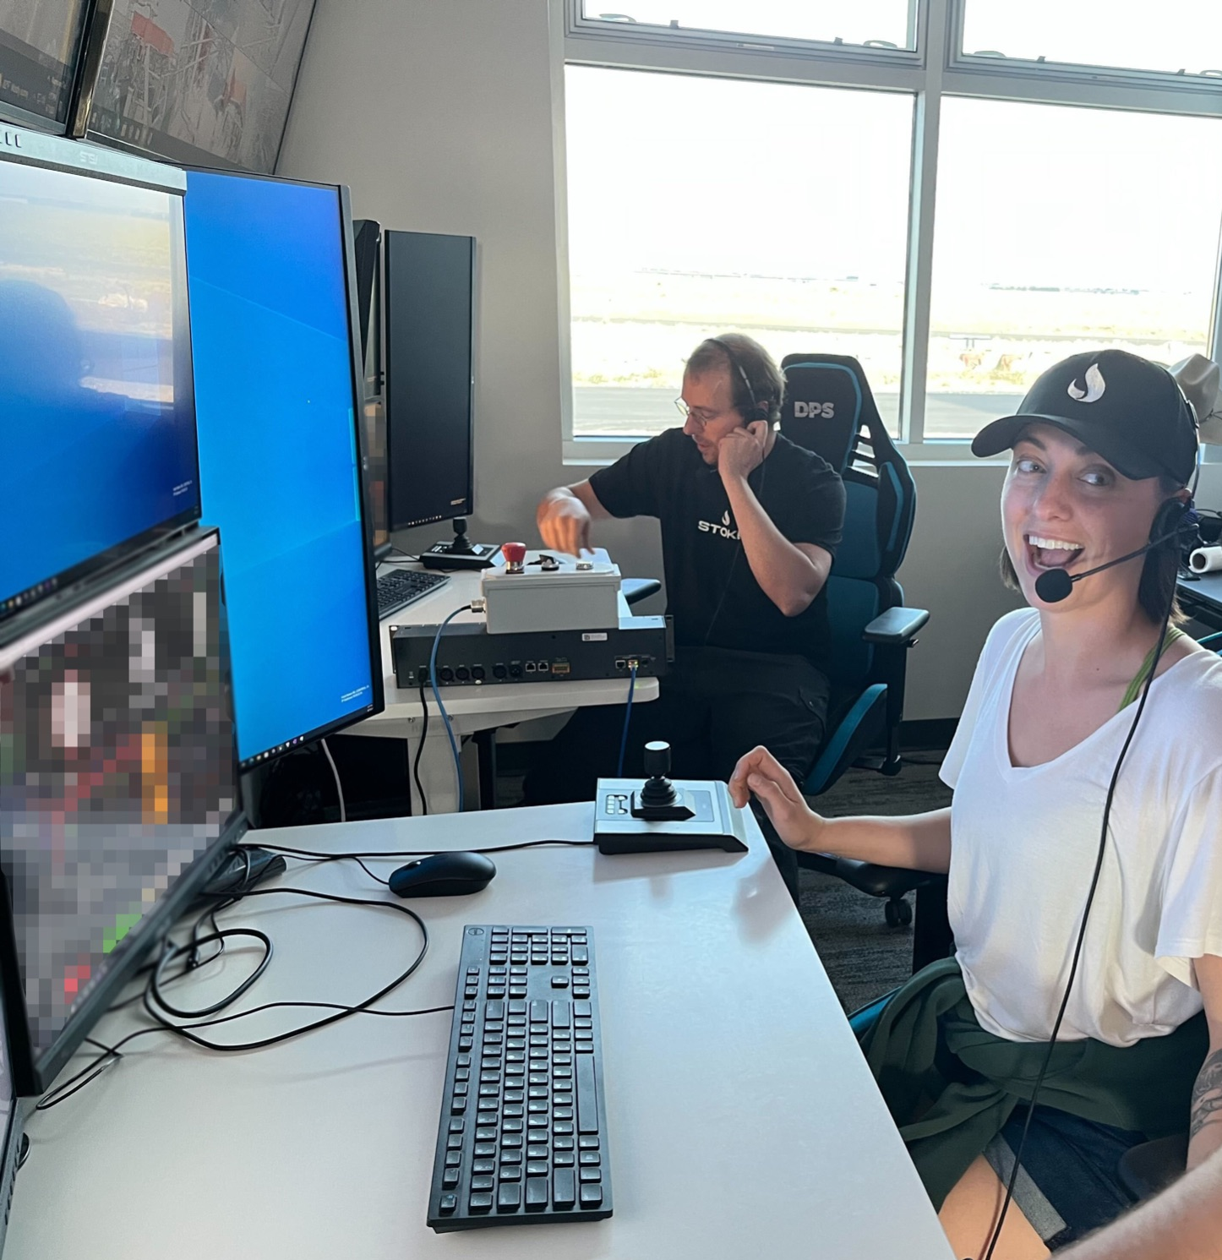
Summer!
Owned development of S1 Engine Power Module firmware and driver
Firmware for custom EPM PCB will communicate commands and telemetry with driver on flight computer
Research and dev’d driver for UPSs

Slide 4
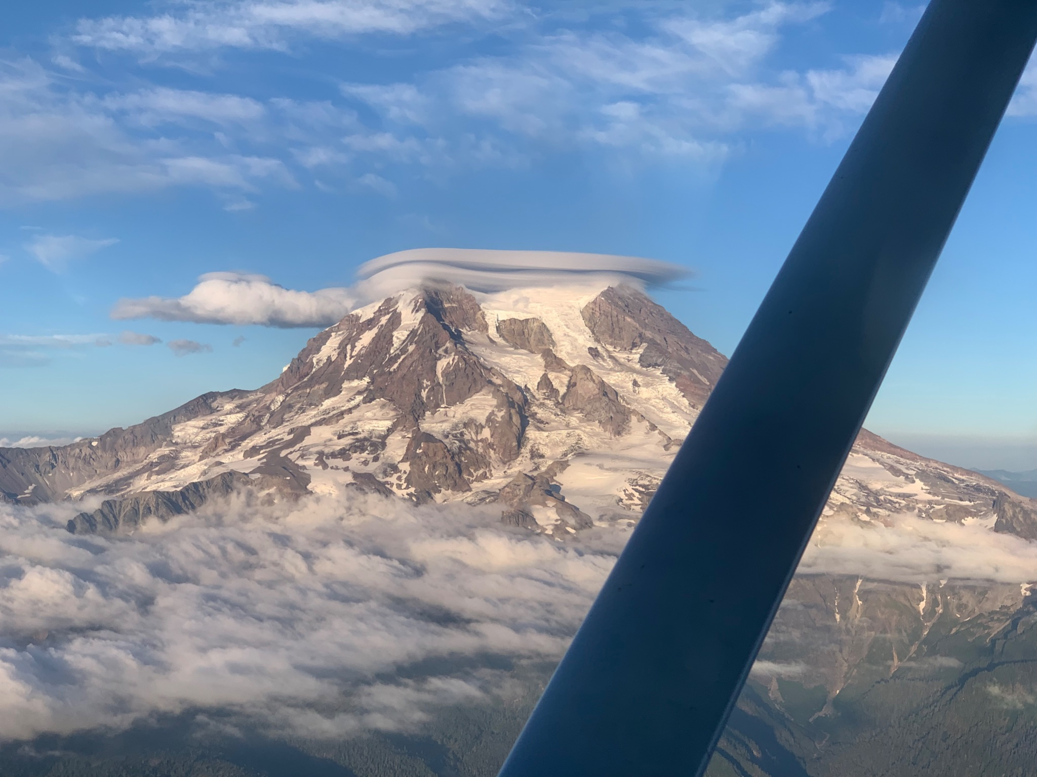

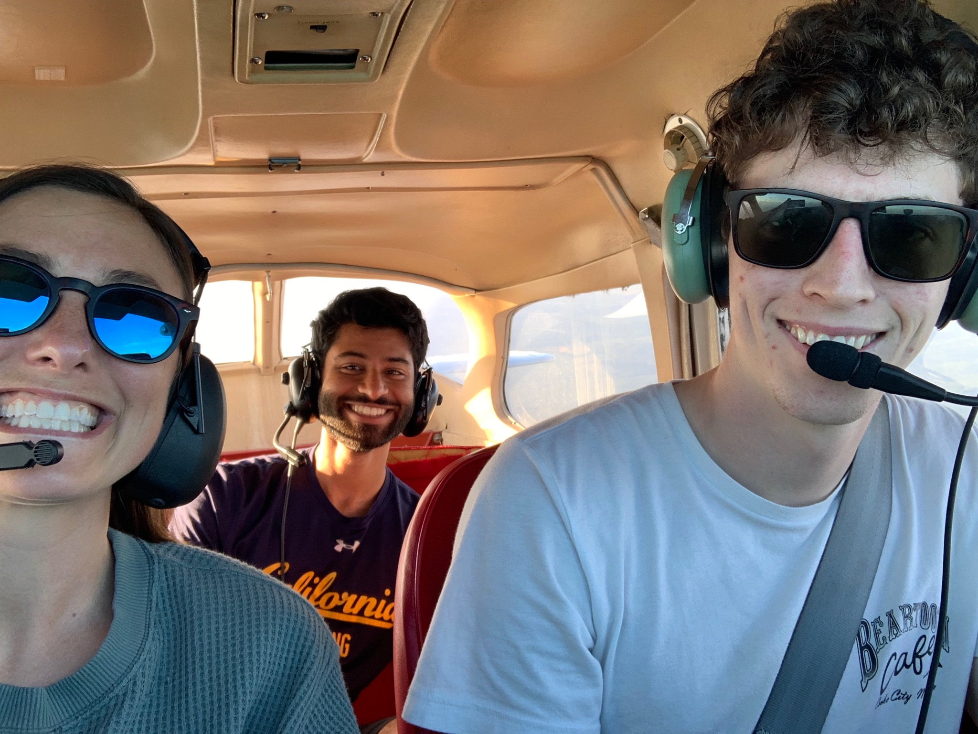
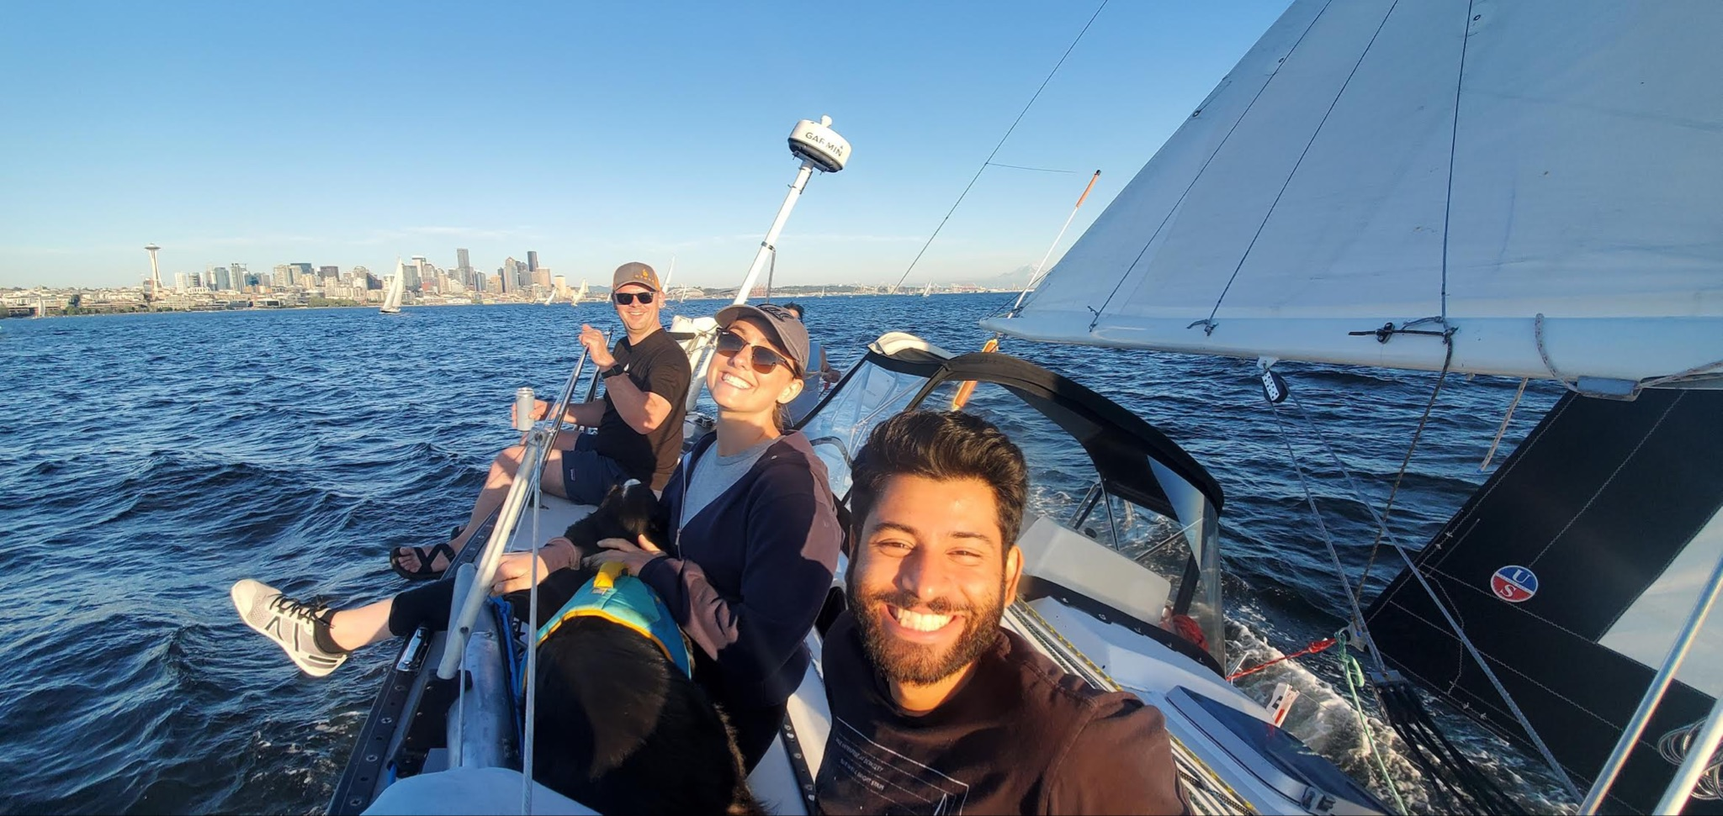
Also lots of Nature and fun

Slide 5
What’s up this semester?
More rocket stuff!
Challenge: how to guide micro-missiles to their target?
Tools given:
AIY Vision Kit
Coral Dev Board Mini: Single-board computer with Edge TPU Module
Nano micro-controller
Coral Environmental Sensor Board
Coral Camera for Edge TPU Dev board

Slide 6
The Plan, so far
Develop understanding of ML, specifically convolutional neural networks
Collect data (images of drones/quadcopters), process images, train and test models for object detection and classification
Run trained models on TensorFlow Lite open source ML framework on Coral Dev Board Mini
Use AIY Vision kit to capture video and feed model on dev board
Implement algorithms to id drone position and calculate needed actuation to keep drone in center of frame
Send algorithms outputs to micro-missile actuators using Nano micro-controller
How do MEMs receive actuation commands?
Still researching uses for Coral environmental sensor board and coral camera
All very new to me, deeply welcoming guidance and feedback

